Slide 1

EPIC Research & Diagnostics, Inc.
Organization
8501 E. Princess Drive, Suite 100
Scottsdale, AZ 85255
www.epicdiagnostics.com
EPIC Research & Diagnostics, Inc. Organization Confidential & Proprietary
Document Number: QA-012 Page 1
Version Number:007

Slide 2
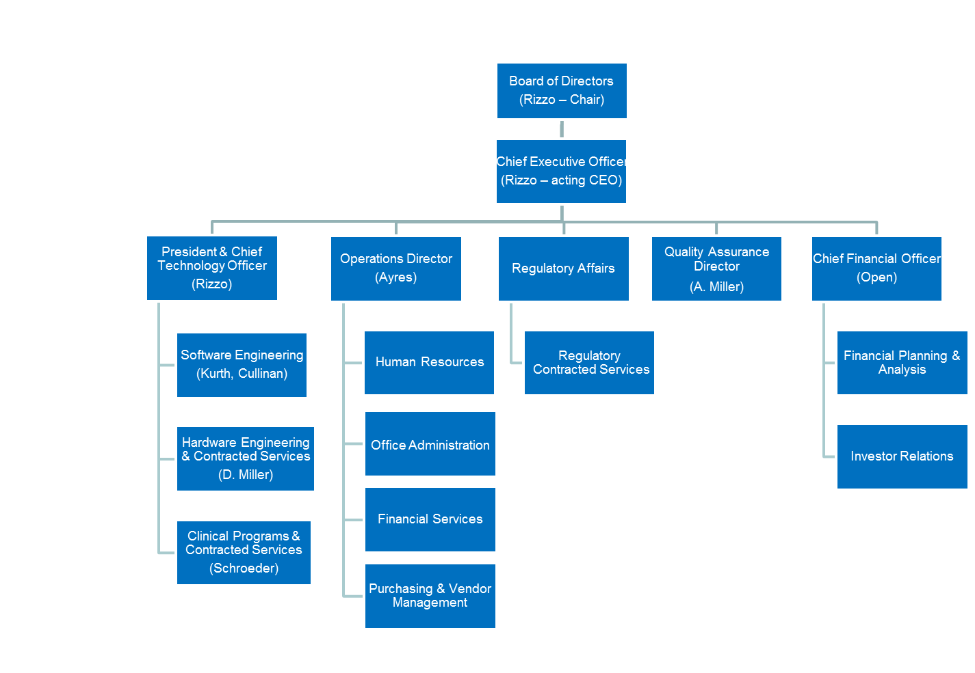
EPIC Research & Diagnostics, Inc. Organization Confidential & Proprietary
Document Number: QA-012 Page 2
Version Number: 007

Slide 3

Organization
Document Revision History
Change Order Number: | Version Number: | Description of Change: | Date: | Updated by:
CC-091409-02 | 000 | New Document | 10/08/09 | AM
CC-110810-01 | 001 | Revisions to organization chart to reflect current organizational structure and to update corporate address. | 8/12/11 | J. Ayres
CC-120127-01 | 002 | Revisions to organization chart to reflect the use of contract services and their relationship within the company structure. | 1/26/12 | J. Ayres
CC-120229-01 | 003 | Revision to organization chart to add Quality & Program Management Director position. | 3/3/12 | J. Ayres
CC-120821-01 | 004 | Revisions to organization chart to add Clinical Programs Director, Senior Software Architect, and Manufacturing Engineer positions. | 8/21/12 | J. Ayres
CC-121214-01 | 005 | Revisions to organization chart to add Medical Science Liaison position, remove two employees who have left company, make three title changes, and move one employee to a different area of work. | 12/14/12 | J. Ayres
CC-130122-01 | 006 | Revisions to organization chart to reflect staffing changes, change of quality assurance position to contract services, and addition of student intern position. | 1/25/13 | J. Ayres
EPIC Research & Diagnostics, Inc. Organization Confidential & Proprietary
Document Number: QA-012 Page 3
Version Number: 007

Slide 4
Organization
Document Revision History
Change Order Number: | Version Number: | Description of Change: | Date: | Updated by:
 | 007 | Revisions to organizational chart to reflect addition of full-time quality assurance position, resignation of CFO, and reassignment of other areas of responsibility. |  | J. Ayres
EPIC Research & Diagnostics, Inc. Organization Confidential & Proprietary
Document Number: QA-012 Page 4
Version Number: 007

